Slide 1
TrackMaster
Taha Abbas - Automation Analyst
Reed McAlpin - Developer
Amit Nyamagoudar - Project Manager
Nivethaa Ravichandran - Developer
Avinash Singh - Business Systems Analyst

Slide 2
Background
What is the EFDC?
What is the problem they are running into?

Slide 3
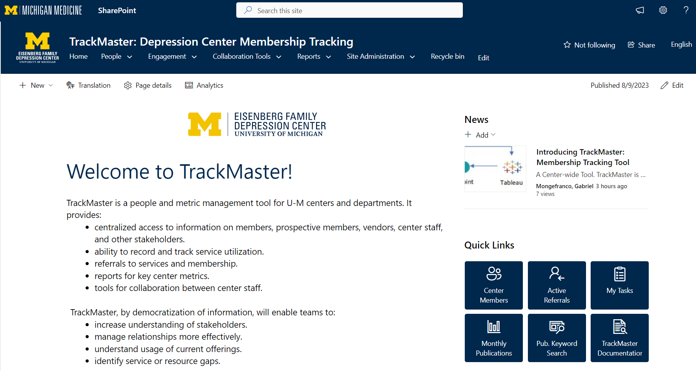
Trackmaster
Centralized tracking tool concept
Efficient, Easy to use, Synergistic
Adaptable - not just for Eisenberg Center, but for other institutions as well
Notes:
Amit

Slide 4
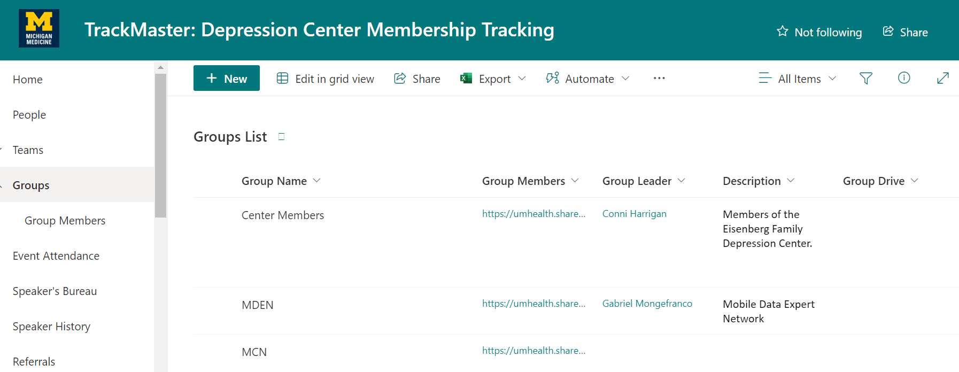
Sharepoint
What is Sharepoint?
List Features
Power Automate

Slide 5
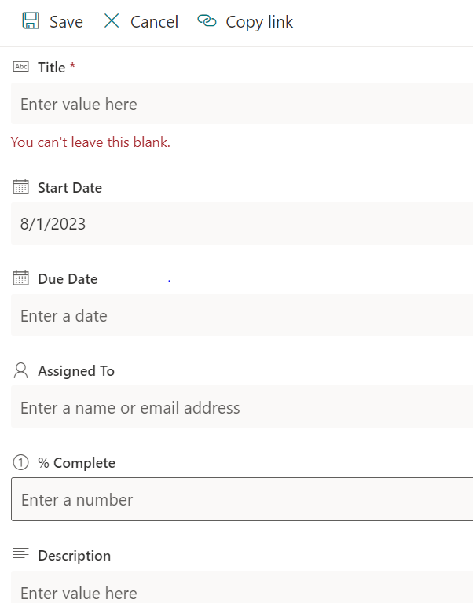
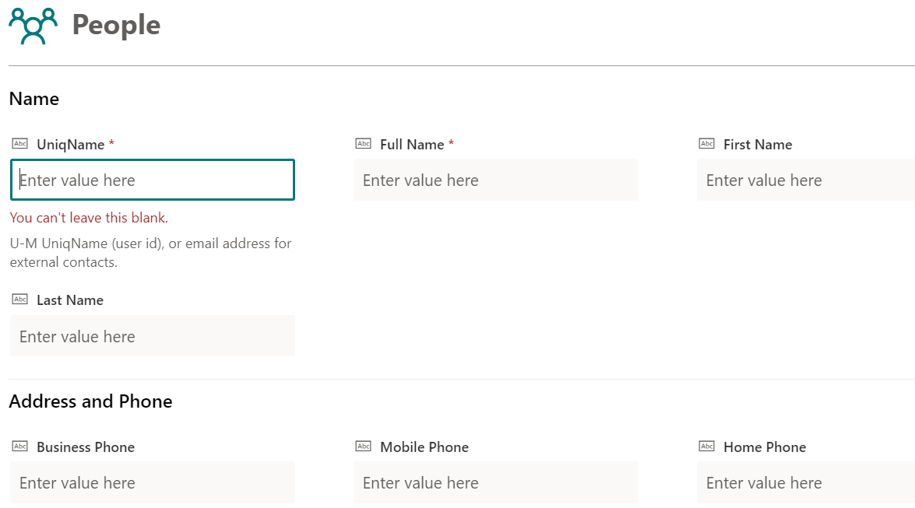
Form Customization
This groups the related columns in a list under a common title
Street Address,State,Country,Zip columns can be grouped under a common title "Address"
Notes:
Reed

Slide 6
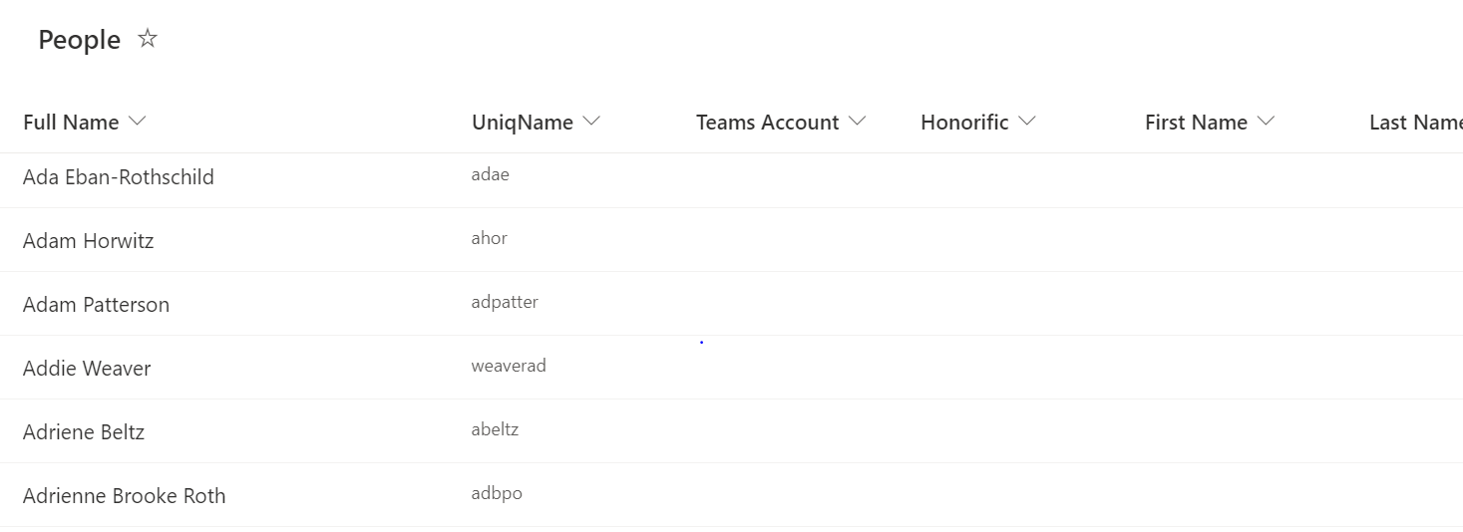
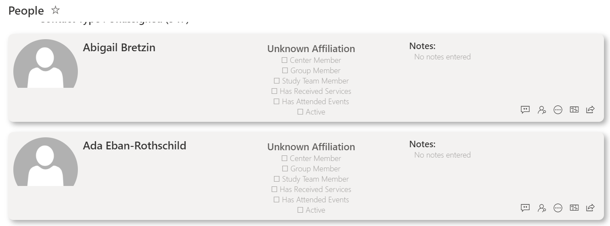
List Customization
Change the default appearance of the list.
Customize the list by changing the json code.
Notes:
Reed

Slide 7
Power Automate
Automatically add users to the people and group members lists when every someone new is added to the Mcommunity (data directory).
Marking people inactive in the group members list whenever they are no longer in the data directory.
Send bulk emails automatically
to users simply by selecting
From the people’s list.

Slide 8
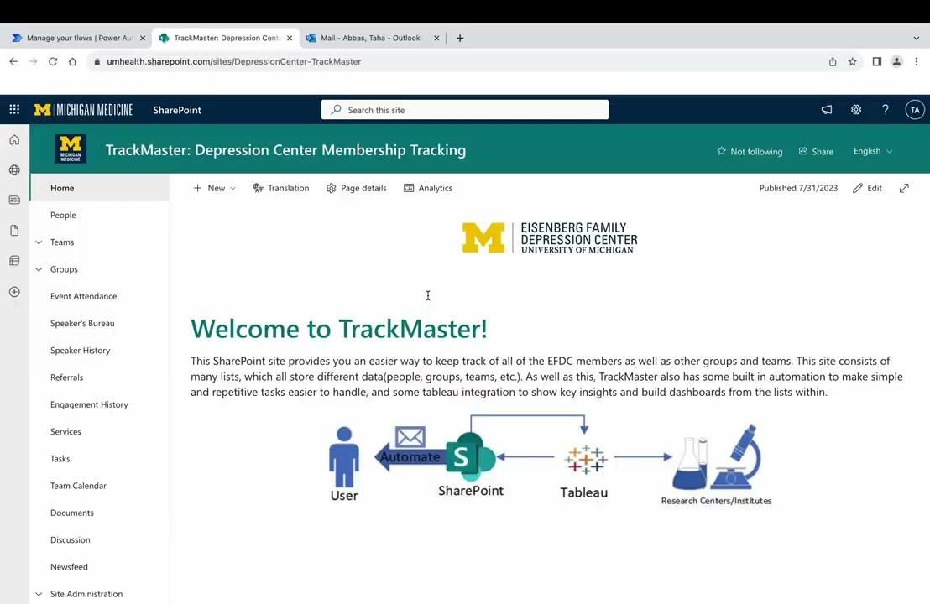
Demo Automation

Slide 9
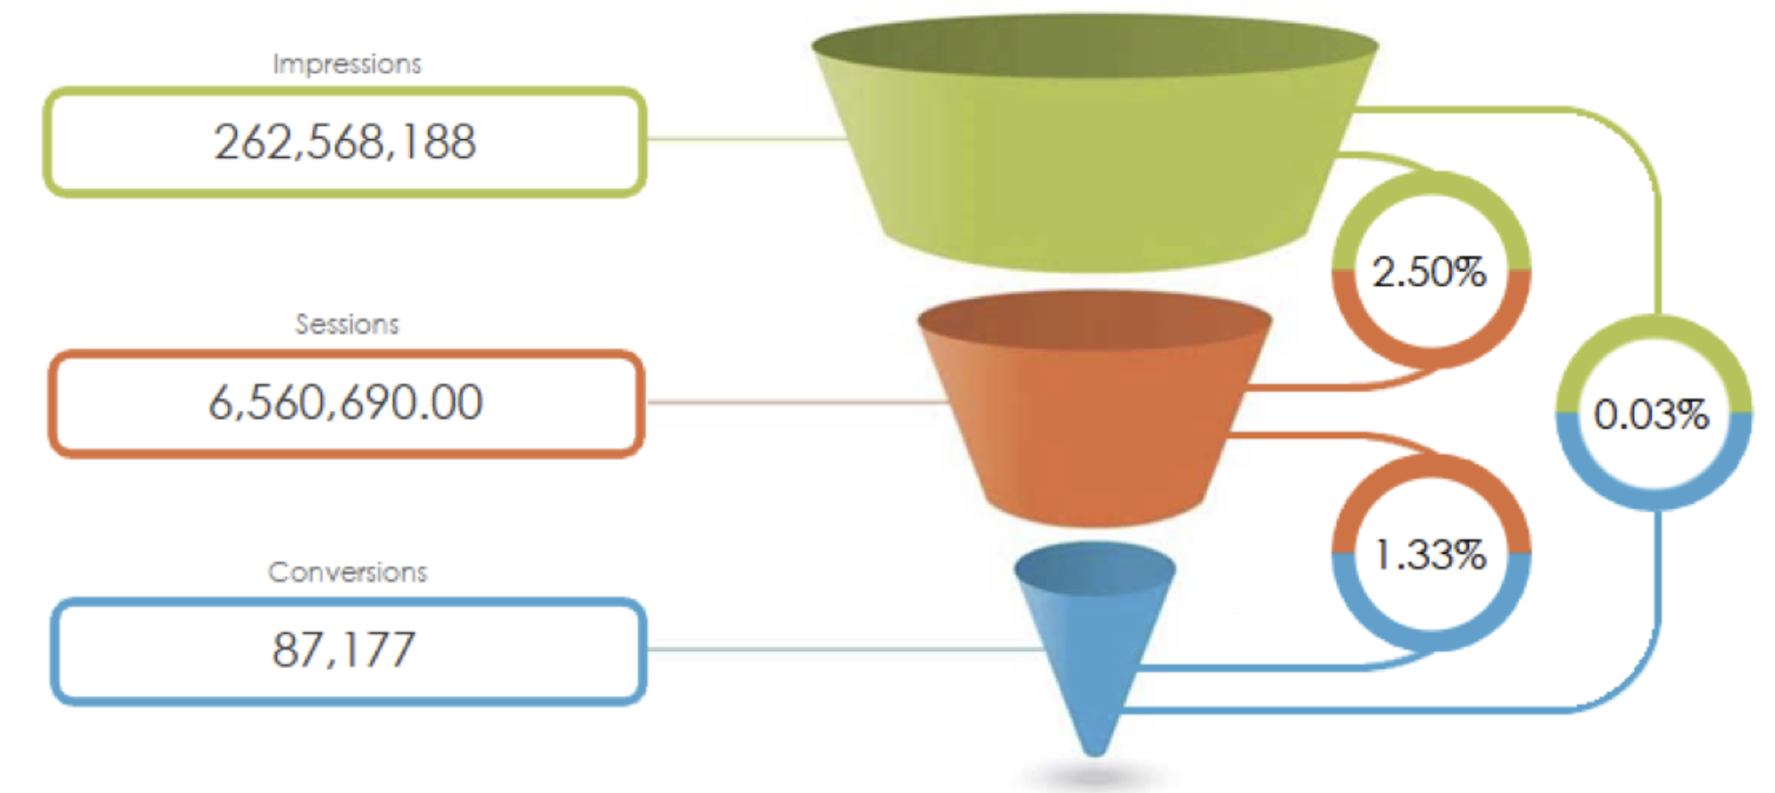
Tableau
Business Intelligence Analysis Tool
Multiple Data Sources and Flexibility
Data Manipulation and Ease of Customization

Slide 10
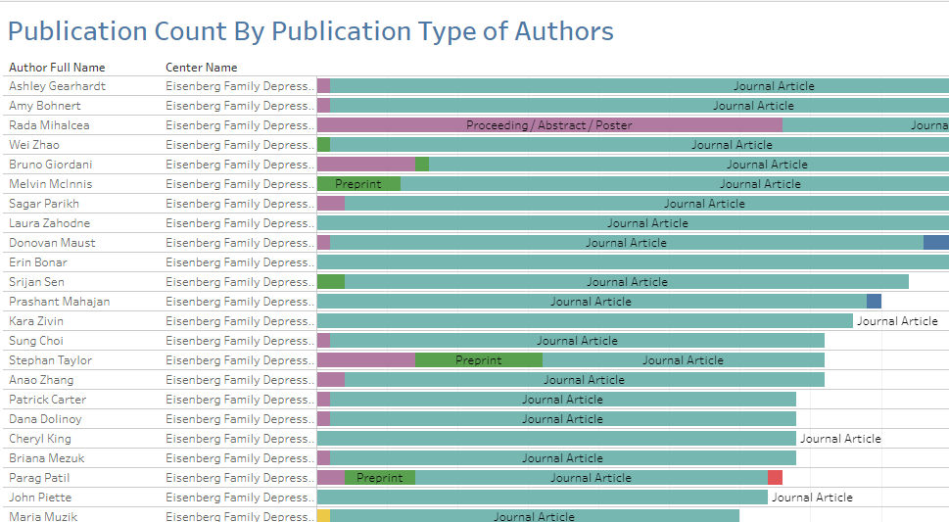
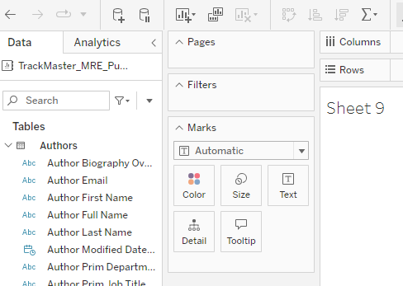
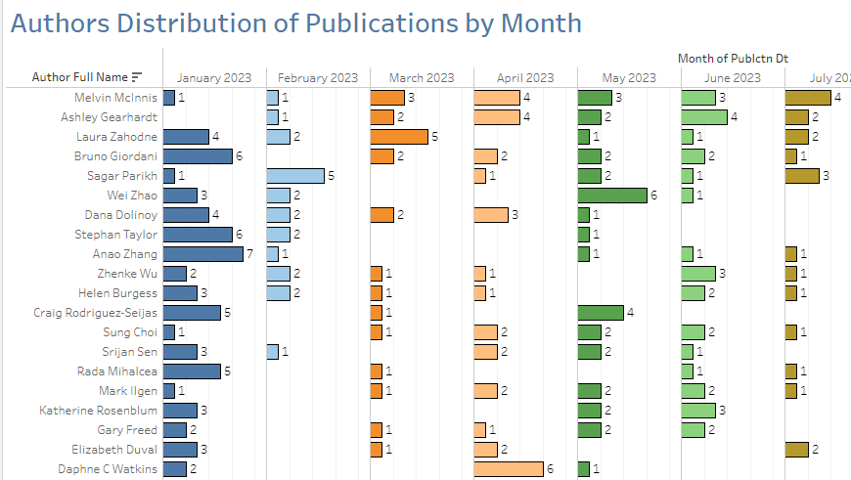
Tableau
Once a data source is ready, it can be used into a workbook, using which, we make visualizations.
Filters and other Markers are used to categorize variables according to their use.
Publications data focuses on Authors at the University.

Slide 11
Questions?

